Slide 1





Motion Analysis Using Artificial Intelligence Tools
CODIT20, 2020
Pierre Moreau, David Durand, Jérôme Bosche, Michel Lefranc
Notes:
Mettre logo codit20
Voir la taille des polices

Slide 2
Contents:
Context
Our approach
Experimentation
Results
Conclusion and perspective
Notes:
Bandeau en bas avec le plan
Numéro de slide
Augmenter la taille
Titre pour la partie 2 : je présente pas la maladie

Slide 3
Context
Analysing the movements of the Parkinson’s patient
Detecting interest movements
Project’s objective : Improving the treatment of patients
Further détails
3 kinds of the Parkinson’s disease
Each type has its own treatment
The patient must remain under observation for several days

Slide 4
Context
1. Motion Capture
2. Learning and analysis
3. Situation detection
Smart Box
sensors
Reasoning layer
Rigidity
Tremors
The Parkinson’s disease
Database
Bradykinesia
φ,θ,Υ
Frequent falls
Freezing
Notes:
Remplacer par « diapo noir »

Slide 5
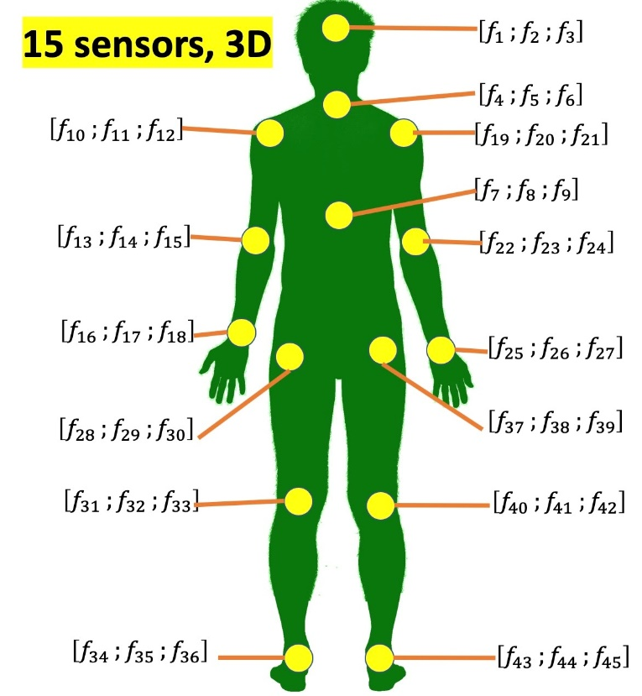
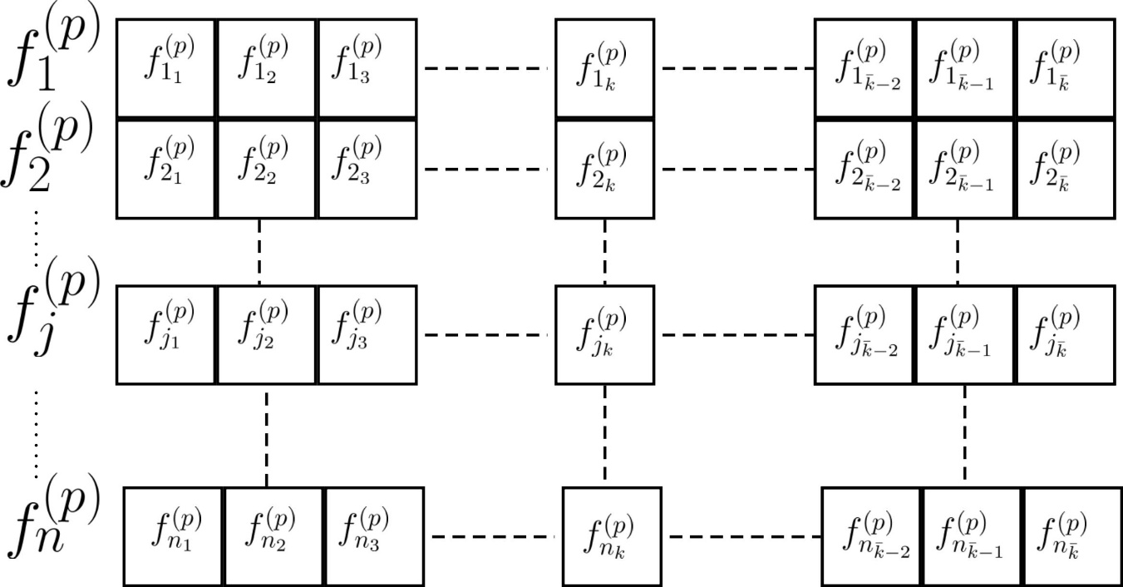

Our Approach Input data
Modéliser la dynamique du mouvement à partir des coordonnées
Une séquence de mouvement p : c’est une représentation vectorielle avec n signaux et k échantillons
n = 15 sensors * 3 d
1
n_$\overline{k}$
Notes:
Ajouter texte pour expliquer
Mettre k barre

Slide 6
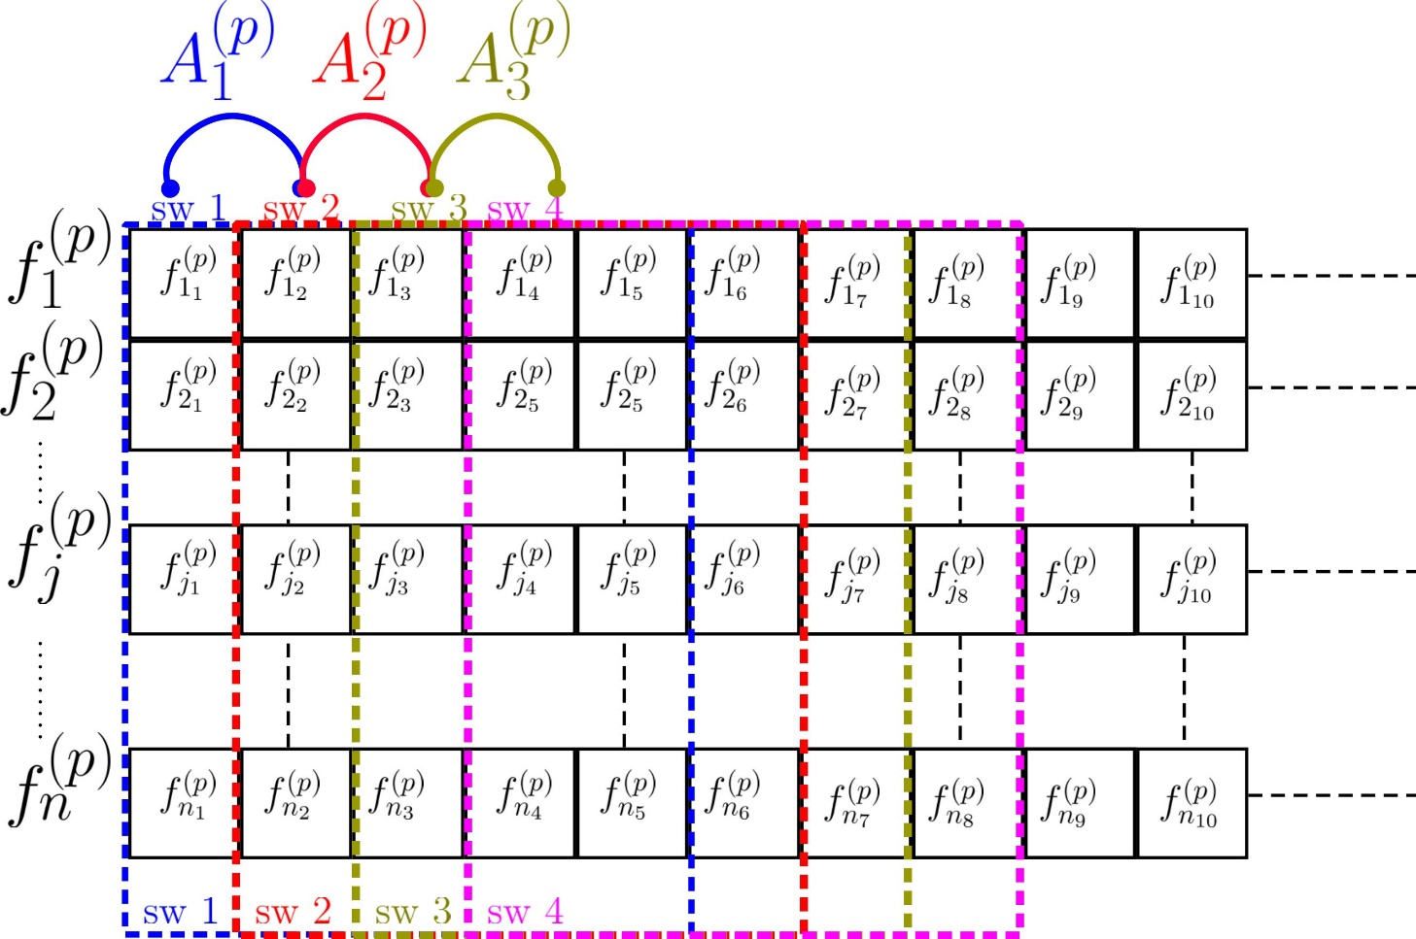
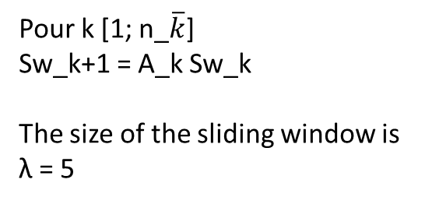
Our Approach Using a Sliding Window
Pour k [1; n_$\overline{k}$]
Sw_k+1 = A_k Sw_k
The size of the sliding window is λ = 5

Slide 7
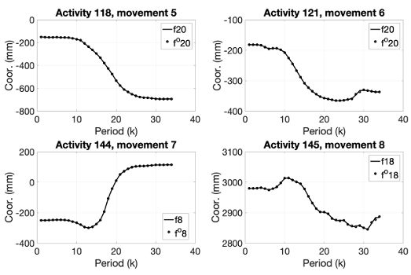
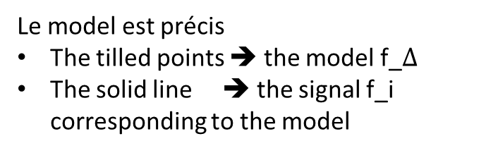
Our Approach Frame Modelling
Le model est précis
The tilled points ➔ the model f_$Δ$
The solid line ➔ the signal f_i corresponding to the model
Notes:
The model f_(losange)

Slide 8
Our Approach Detection stage
Separation of learning and test data
For each period k, ∀k ∈{1,..,34}, repeat :
Generate the corresponding 34 vectors
Calculation of the coefficient of resemblance φ
Generate the matrix resulting from the concatenation of φ and campute ϒ, the column vector of mean values of each row
Extract the largest value of ϒ, which is the movement detected
Checks if the detected movement matches
Compute the score of our approach

Slide 9
Experimentation Florence University database
Motion captured by kinect camera
9 activities
Wave
Drink from a bottle
Answer phone
Clap
Tight lace
Sit down
Stand up
Read watch
bow
10 subject
➔ 215 activities in total
Experimentation Out-i
The actor i is removed from the database to test the algorithm
All others actors are used to train the algorithm
This is repeated one time for each actor
Notes:
Expliquer à droit l’expériementation : out-i ➔ on prend toutes les activités excepter l’acteurs i pour l’apprentissage et le reste pour le test, le tout 10 fois

Slide 10
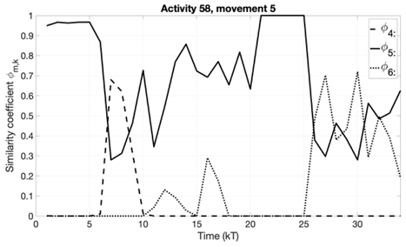
Results Recognition Accuracy Case OUT-3, Activity 58 movement 5
Right detection

Slide 11
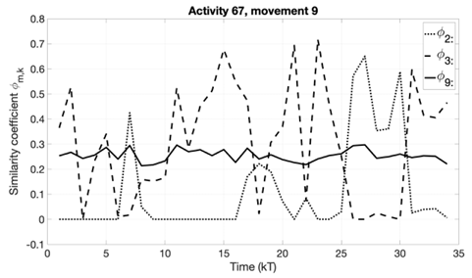
Results Recognition Accuracy Case OUT-3, Activity 67 movement 9
False detection

Slide 12
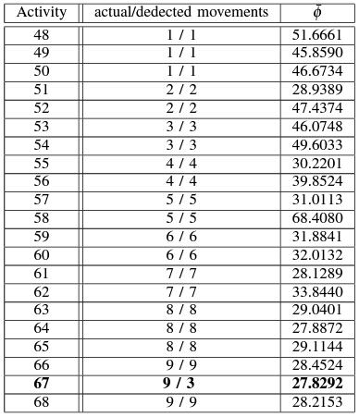
Results Summary of results – case out-3
In this case, only 1 movement is not detected out of 21

Slide 13
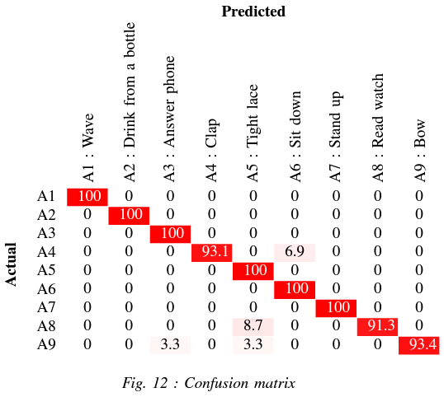
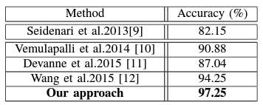
Results: Recognition Accuracy Comparison

Slide 14
Conclusion and Perspective
The algorithm
can be applied to any type of movement
Considers a discret-time state modeling valid over a short « time window »
The movement
Modeled by a convex formulation of the state models
This lead to an similarity index of the actual movement with the learning models
Perspective
A test clinic that will take place at the CHU Amiens with the neuron suit pro
It will allow us to build a database of the University of Picardie Jules Verne
This database will be used for application purposes

Slide 15
References
[9] : L. Seidenari and all, 2013
[10] : R. Vemulapalli and all, 2014
[11] : M. Devanne and all, 2015
[12] : C. Wang and all, 2016

